Slide 1
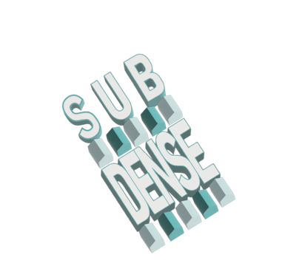

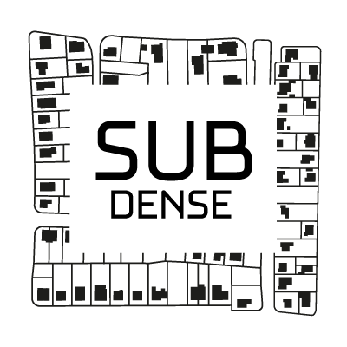



A Collaborative Dashboard to Study Periurban Densification
Mouhamadou Ndim¹, Juste Raimbault¹
Bénédicte Bucher¹, Ana-Maria Raimond¹,
Julien Perret¹
¹ LASTIG, Univ. Gustave Eiffel, IGN-ENSG, France
ECTQG, Braga, September 2023
Notes:
Good morning, I am MN from LASTIG lab at IGN, you also have my colleague JR, we are both working on the subdense european project to design and implement a collaborative dashboard to study periruban densification.

Slide 2

The SubDense Project
The SubDense European project aims at better understanding the polyrationalities of space, actors and policies on suburban densification, by :
exploring how diverse strategies of land policy interact with landowners’ and local stakeholders’ interest and agency to shape suburban densification and their impact on suburbia across different planning systems (France, Germany, UK);
combining quantitative approaches (geodata analysis and geosimulation) with qualitative approaches (social and policy science and planning).
Notes:
The subdense project is a collaboration between IGN in France, University of Liverpool in UK, and TU Dortmund and IOER in Germany.
It aims at suburban densification to solve problems linked to urban sprawl or the overdensification of centers.
However, many planning challenges arise to implement suburban densification, due to the polyrationalities of stakeholders.
The project combines qualitative interviews of stakeholders with data-driven analysis, on 6 urban areas in the 3 countries.

Slide 3
Project research objectives
WP1: Which data, information infrastructures and approaches enable a comparative spatial analysis of suburban densification and allow for an integration of stakeholders’ interests and agency?
WP2: How can stakeholders’ interests and agency be explained in relation to land policies for suburban densification?
WP3: How do land policies respond to the interests and agency of stakeholders in an effective and efficient way?
Notes:
The project has 3 complementary axes: first how to enable a robust comparative analysis on heterogeneous data across countries; second investigate the role of stakeholders; and third explore land policies for densification.

Slide 4
Dashboard and Geodata analysis
Describing change in urban density with comparative data and matching libraries
Discerning densification patterns with social data and in depth comparative analysis
Decoding ground knowledge on densification
Aims of this research contribution :
Create a dashboard that will be a tool for collaboration and sharing between partners, enabling the exchange of data and methods, as well as the exploration of results through geovisualization.
Notes:
Our contribution at IGN and which is my main task, is part of Work Package 1 and is to build a dashboard as a collaborative tool.
The dashboard is a mean to share methodologies and tools, expertise on data, results from data analyses, etc.
It is also designed to be an explorative tool through geovisualisation.

Slide 5
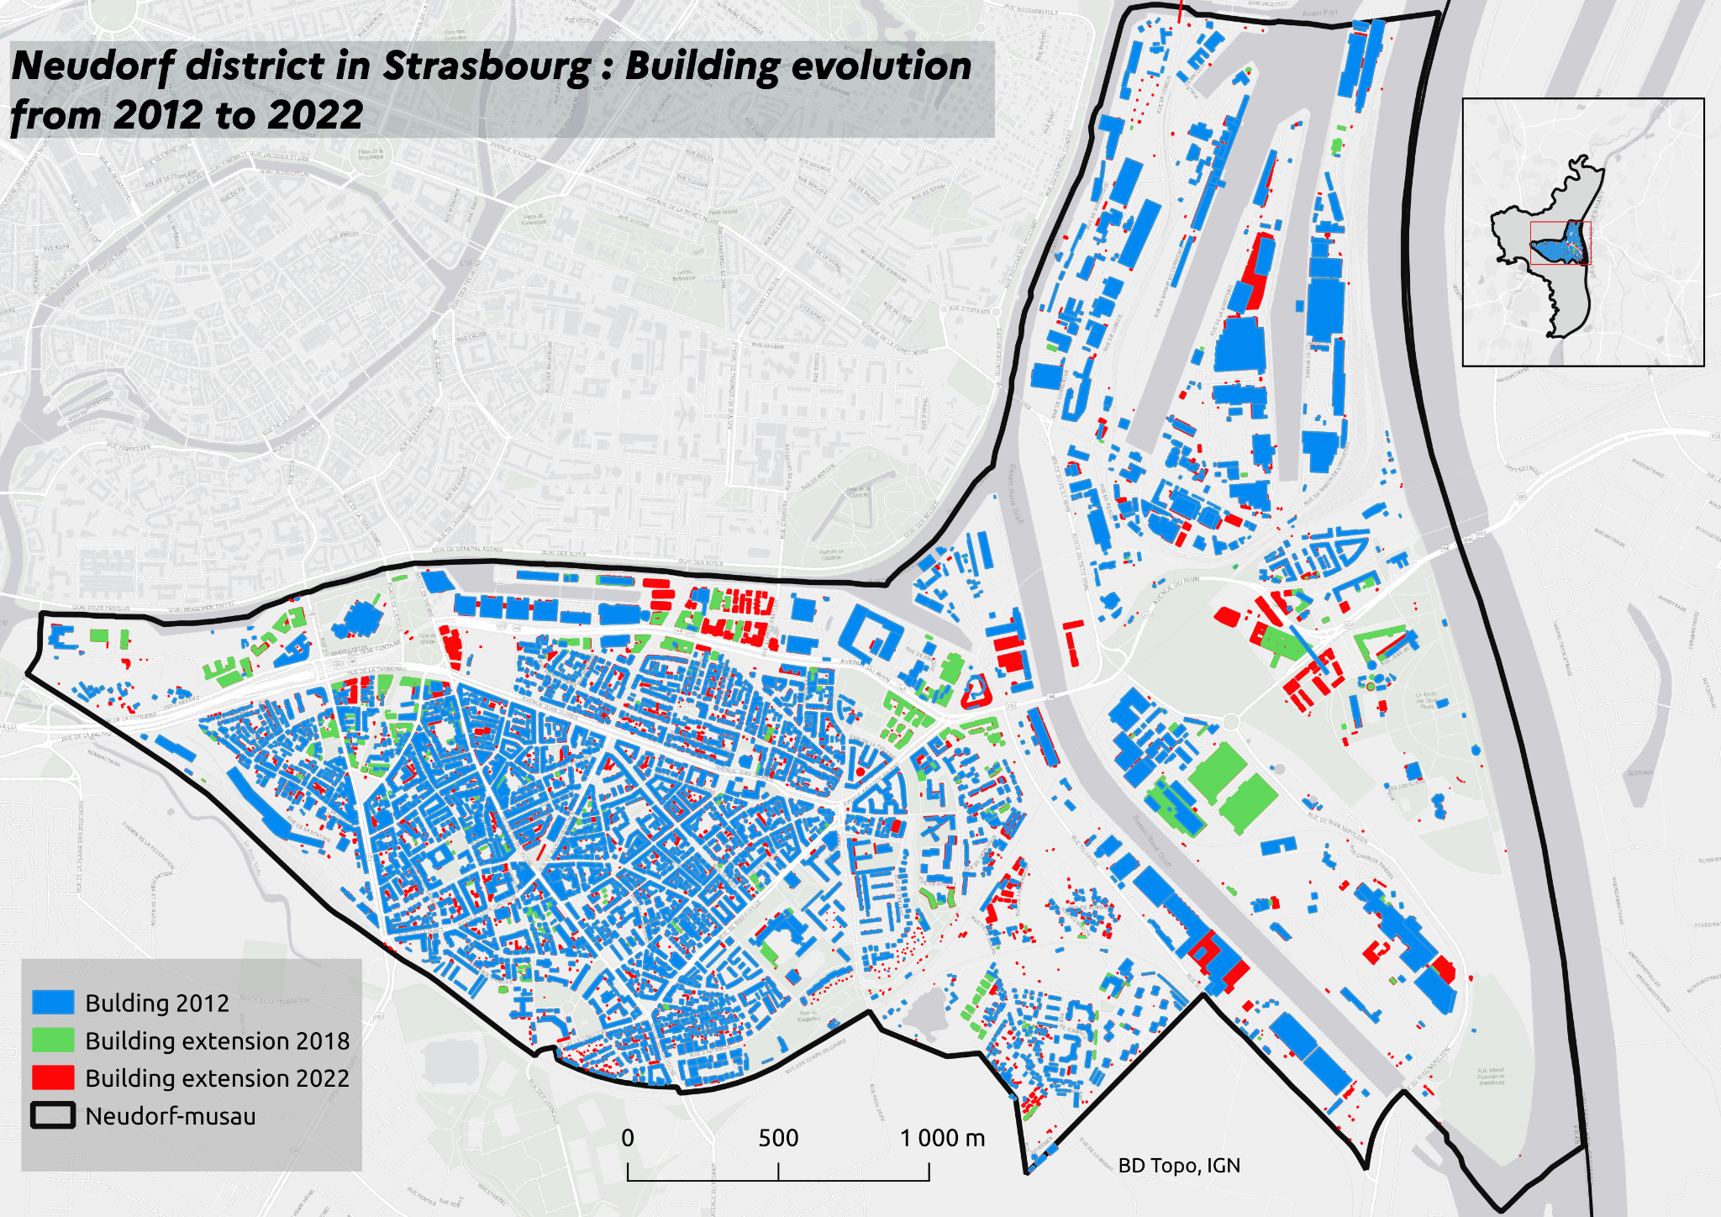
Data expertise and analysis
How to share analysis and methods for reproduction on other case studies?
How to integrate this knowledge on data specification into the dashboard so that it is discoverable and reusable by partners?​
Notes:
Analyses on densification are shared between partners.
This example map of building change shows urban extension in Strasbourg between 2012, 2018 and 2022.
The country-specific data expertise is also shared between partners with metadata.

Slide 6
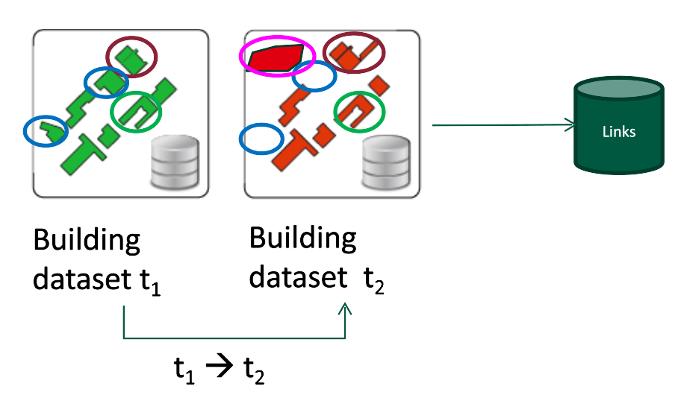
Materials and Methodology:
Polygon matching algorithm for building change detection
Typology of changes​
1:1 stability​
1:1 no change, but geometric modification​
1:1 no geom change, but use change​
1:1 no geom change, but height change​
1:0 destruction​
0:1 construction​
1:m split​
n:1 fusion​
n:m aggregation
Notes:
Another important aspect of the collaborative dashboard is the sharing of methods and their implementations.
These analysis tools, for example the matching algorithm shown here developed by LASTIG, can be used by other partners on their own datasets.
Here, a polygon matching algorithm is used for building change detection, through a typology of matching links.
For example, a one to one matching link is building stability, while a missing link is destruction or construction.

Slide 7
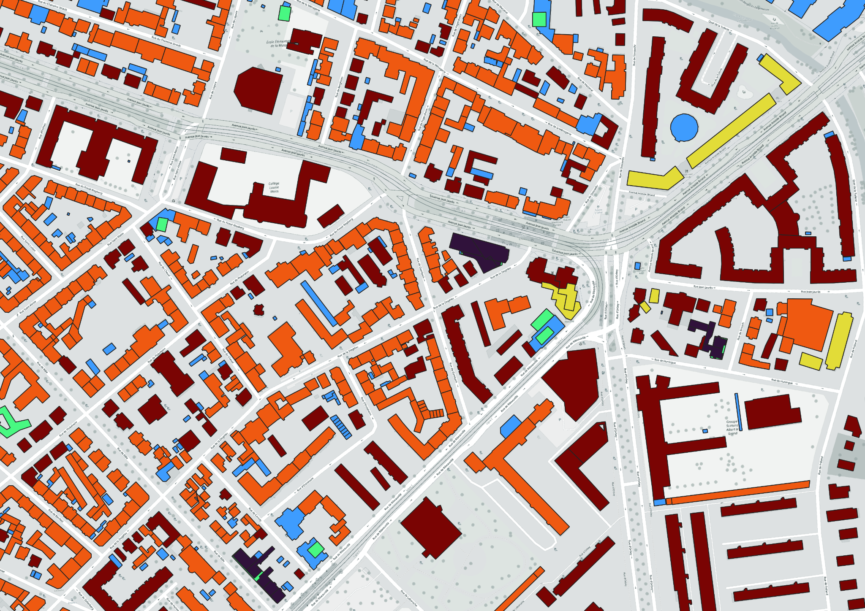
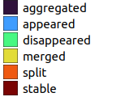
Current application to Strasbourg data (2012-2022)
Interpretation :
Quickly identify areas where there has been significant growth (by focusing on "appeared" buildings), or conversely, areas where buildings have been removed or demolished (by focusing on "disappeared").
The split, merged and aggregated types provide information on how land use or zoning may have changed. For example, in developing urban areas, you might find more buildings that have been split to make way for new construction.
Notes:
Here is an illustration of some densification analysis results that can be shared for comparison between countries.
The map, obtained through matching for building change detection, allows identifying quickly areas of significant change between 2012 and 2022.
Hypothesis can be drawn from exploring the map, such as change in land use or zoning, which will be later investigated through qualitative fieldwork.

Slide 8
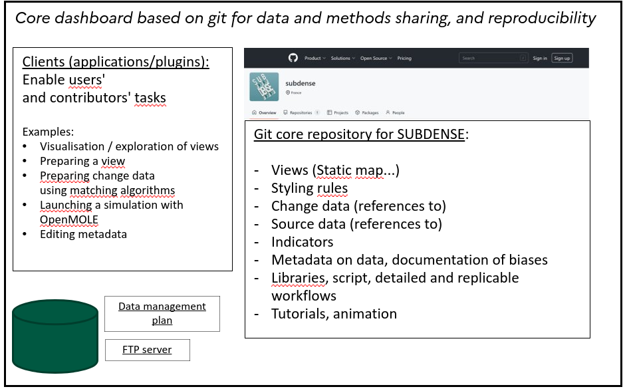
A Collaborative Dashboard
The git-based architecture for the core dashboard ensures tractability, full history, reproducibility, flexibility, and collaboration through branching, shared remote repository (https://github.com/subdense)
Clients will implement interactions with the core and functionalities needed by partners for data analysis and integration (running change detection algorithms,adding data, exploring results and maps, . . . )
An iterative process to produce user stories, finally leading to some specifications for the core architecture and functionalities of clients.
Notes:
We propose an innovative architecture for the dashboard, using the git software as the core infrastructure.
git ensures a full reproducibility, tractability and collaboration of the process.
A central git repository gathers all information, results from analysis, metadata, and pointers to data.
Clients will interact with the repository for different functionalities: a qgis plugin for analysis (under development), an interactive html front-end (dashboard in the classical sense)

Slide 9
Types of dashboard users involved in the collaborative specification of core and clients functionalities
“User stories” are iteratively co-constructed to specify needs, requests, contributions, etc. of various users
END USERS​
Exploit the visuals to produce knowledge related to densification​
Interact with operational stakeholders​
Specify the concepts to be studied ​
Search for "indicators" ​
Engage in the criticism of "indicators" and proposal of new indicators​
CORE DESIGNERS​
Provide core structure, GUI, workflows​
DATA EXPERTS​
Identify data, tools, …
Design innovative data, tools, ​
DATA CONTRIBUTORS ​
Produce change data, integrate data, produce visuals
Notes:
The dashboard is also collaborative in the sense that its functionalities are determined by different users.
The concept of “User Stories”, which are a narrative translation of a given practice, is used.
These stories are iteratively built by exchanging between various types of users, including some involved in dashboard development.
The users also include end users, data contributors, data experts.
In some sense, the construction process of the dashboard itself is part of the dashboard: this ensures a form of reflexivity, crucial in Open Science.

Slide 10
Interactive front-end of the dashboard
.md files in the git repository, edited through partners’ commits, are automatically converted to html using pandoc
github pages - automatic deployment of a website from html pages in a git repository, are used for continuous integration
current work to: (i) automatise the deployment of an interactive mapping sub-page from a current state of the git repository; (ii) integrate both aspects into a single front-end; (iii) integrate a git interaction within the front-end, using a javascript library for git
Notes:
Let’s detail the implementation of one client which is the interactive front-end (“classical” dashboard)
A web page is automatically updated when a repository action happens through continuous integration, allowing continuous deployment on github pages
We are currently working on the inclusion of interactive maps in the webpage.
Future work will include more interactivity with the git from the webpage.

Slide 11
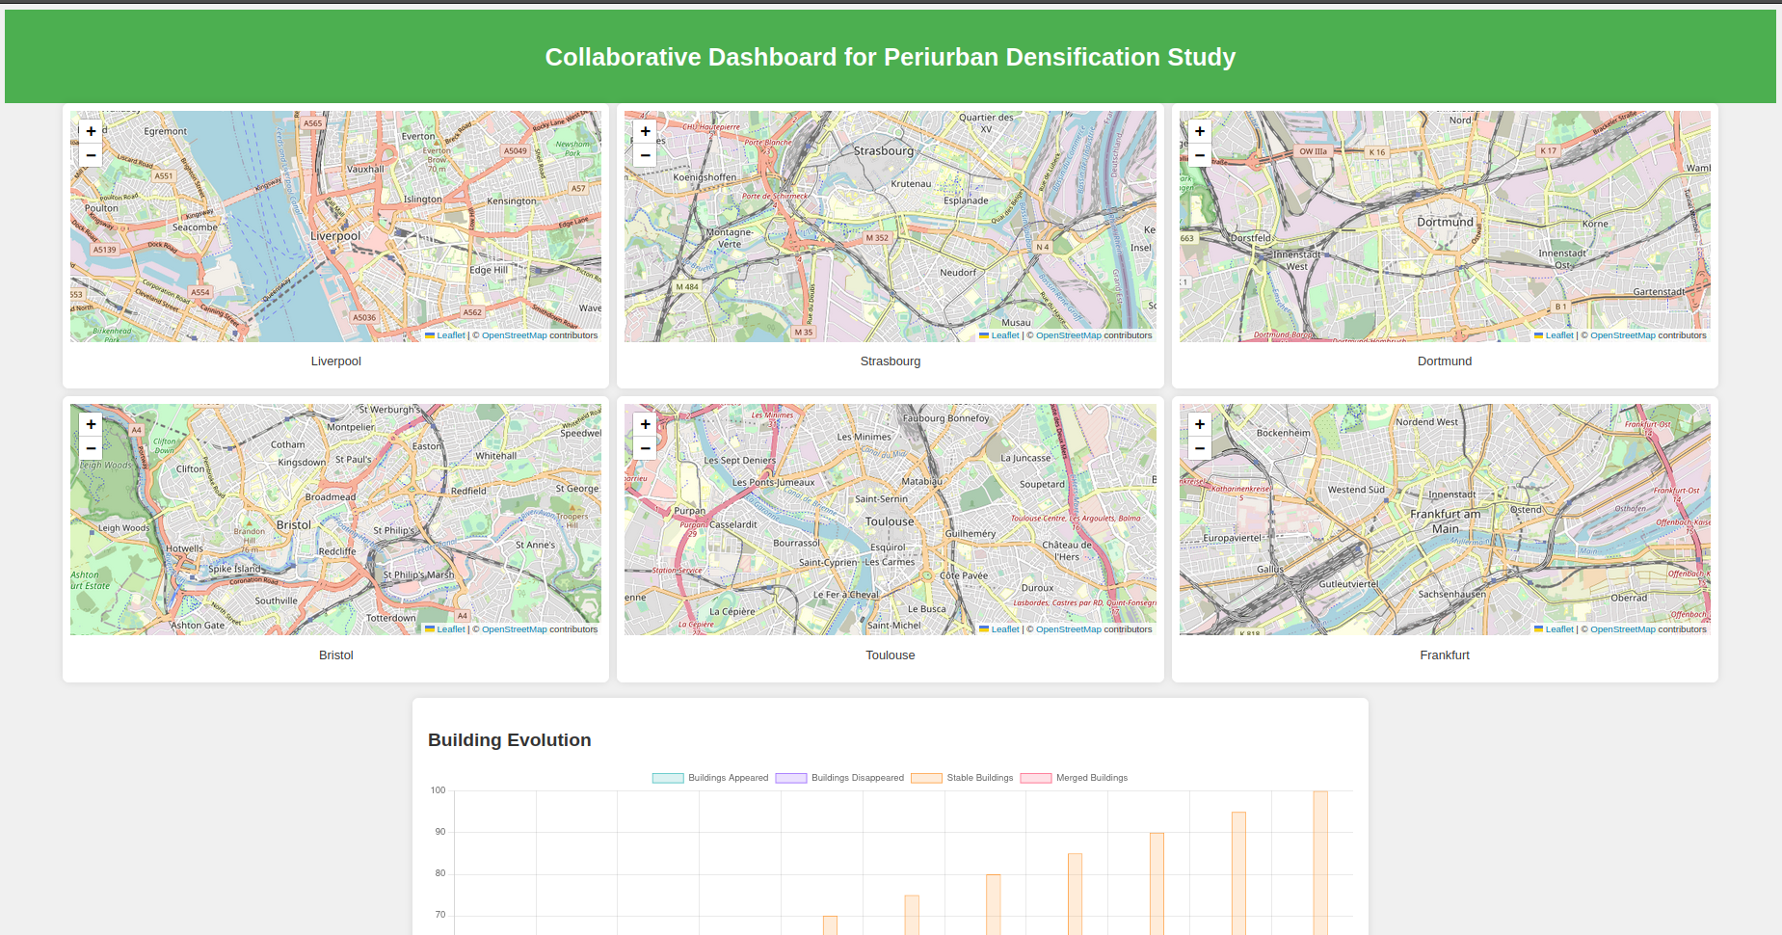
https://subdense.github.io/dashboard/
Notes:
This illustration of dashboard functionalities is the interactive comparison of studies areas.
Partners with less knowledge of quantitative analysis can used this to draw hypothesis and explore data analysis results.
Here is a short demo of the prototype dashboard: [follow link]
This maps show the study areas obtained with 45 minutes isochrones.

Slide 12
Dashboard: synthesis
The dashboard will act as an integrator and mediator between interdisciplinary partners
It is a crucial element in avoiding bias from the use of heterogeneous data across countries
It is finally a place to share and exchange ideas, but also collect Geospatial User Feedback through metadata
Notes:
I can summarise now the main functionalities of the collaborative dashboard under development.
It will be principally an intermediate between partners.
It enables interdisciplinary dialogue by the exchange of concepts, data, data expertise, results, etc.
It also empowers users with less technical knowledge to execute advanced spatial analysis methods.
It is essential in such a comparative project across countries to share expertise on data specifications which can lead to significant comparative bias.
The concept of Geospatial User Feedback is also implemented in the dashboard with dialogue and feedback collection with metadata.

Slide 13
Research perspectives
Related future work at LASTIG in the subdense project:
heterogeneous data integration (Bucher et al., 2021), to couple densification analysis with socio-economic data and qualitative data from fieldwork within the dashboard;
development and exploration of simulation models for the impact of policies on densification processes, parametrise these models including qualitative data.
Notes:
Finally, we can mention related future work in the subdense project
the integration of heterogeneous data will have to be conducted to correlate indicators with socio-economic context, but also with qualitative fieldwork data
the development of simulation models will allow exploring policies for suburban densification
The SimPLU model developed at LASTIG simulates possible construction using regulations (Plan Local d’Urbanisme)

Slide 14
Thank you for your attention !
Any questions or contributions ?
mouhamadou.ndim@ign.fr
https://github.com/subdense
Notes:
Thanks for your attention - I am looking forward to hear your questions !

